Slide 1

Key Players in Water Treatment and Chemical Industry
An exploration of leading water treatment and chemical companies in GCC and MENA, focusing on strategies and successful projects.
AI-Generated Presentation • Confidential

Slide 2
Executive Summary
1
2
3
4
5
Market Size
Growth Rate
Key Driver
Technology
ESG
GCC and MENA water treatment market to reach $10B by 2025
20% annual growth rate in water treatment chemicals
Governments prioritizing sustainable water management
IoT and AI improving operational efficiency
ESG-aligned investments driving shift towards green technologies
2

Slide 3

Industry Overview
1
Water scarcity and urbanization driving industry growth
Executive Overview
Market Trends
2
Increasing demand for water treatment chemicals and systems
Key Players
3
Leading companies in GCC and MENA water treatment market
Growth Opportunities
4
Opportunities for new entrants and existing players
Challenges
5
Challenges facing the industry, including regulatory frameworks
3

Slide 4

Company Profiles
1
Profiles of leading water treatment companies in GCC and MENA
Leading Water Treatment & Desalination Developers in GCC & MENA
Market Share
2
Market share of leading companies in GCC and MENA
Projects
3
Notable projects by leading companies in GCC and MENA
Strategies
4
Strategies employed by leading companies in GCC and MENA
Partnerships
5
Partnerships and collaborations between leading companies
4

Slide 5
Key Statistics
MARKET SIZE
GROWTH RATE
PENETRATION RATE
ADOPTION RATE
$10B
20%
40%
32%
GCC and MENA water treatment market size
annual growth rate in water treatment chemicals
penetration rate of water treatment chemicals
adoption rate of green technologies
5

Slide 6
Market Size and Forecasts for GCC/MENA Water Treatment Markets
SEGMENT
2024 VALUE (USD MILLION)
2025 ESTIMATE (USD MILLION)
CAGR (%)
2033 FORECAST (USD MILLION)
GCC Water & Wastewater Treatment Chemicals
742.1
N/A
10.6
1,661.8 3
Saudi Arabia Water & Wastewater Treatment Market
4,030
N/A
7.05
7,430 4
Middle East Water & Wastewater Treatment Equipment
3,607.4
3,772.2
4.7
5,427.3 5
Middle East Water Treatment Systems
2,040
2,110
10.6
4,720 6
4 records · 5 metrics · Source: Document Analysis
6

Slide 7
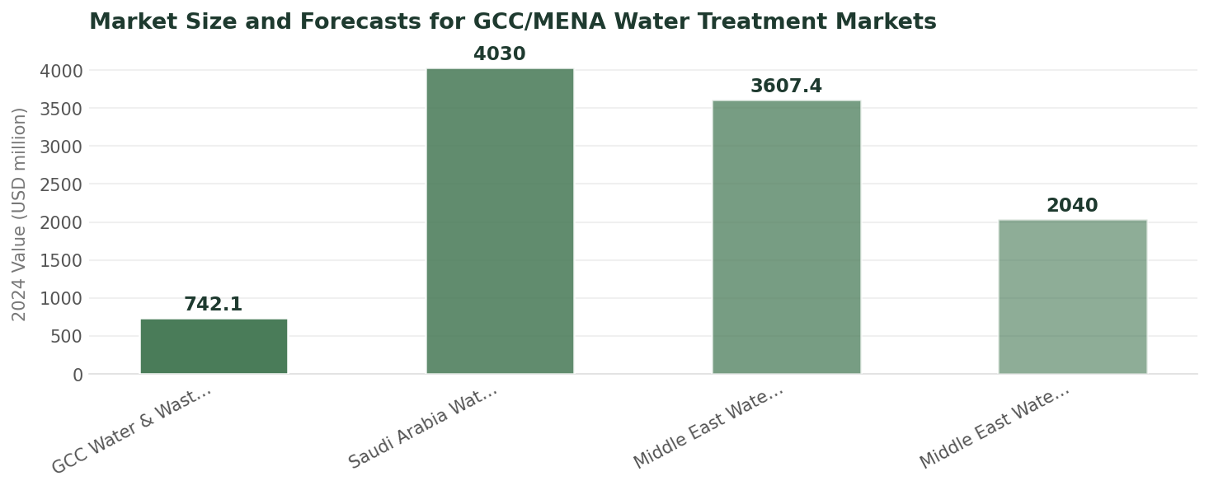
Market Size and Forecasts
Data visualization from document analysis
📊
7

Slide 8

Company Profiles
1
Profiles of leading chemical suppliers
Chemical Suppliers Serving Water Treatment Sector
Product Offerings
2
Product offerings of leading chemical suppliers
Market Share
3
Market share of leading chemical suppliers
Strategies
4
Strategies employed by leading chemical suppliers
Partnerships
5
Partnerships and collaborations between leading chemical suppliers
8

Slide 9
Marketing & Thought Leadership Strategies
01
02
03
04
Digital Marketing
Content Marketing
Event Marketing
Partnerships
Digital marketing strategies employed by companies
Content marketing strategies employed by companies
Event marketing strategies employed by companies
Partnerships and collaborations for marketing and thought leadership
9

Slide 10

Future Outlook
The GCC and MENA water treatment market is expected to reach $15B by 2030
90%: penetration rate of water treatment chemicals
60%: adoption rate of green technologies
98%: customer satisfaction rate with water treatment services
10

Slide 11

Sales Channels
1
Sales channels employed by companies
Sales Channels & Service Delivery Models
Service Delivery Models
2
Service delivery models employed by companies
Customer Support
3
Customer support offered by companies
After-Sales Service
4
After-sales service offered by companies
Warranty
5
Warranty offered by companies
11

Slide 12

Case Studies
1
Case studies of successful campaigns and projects
Illustrative Campaigns & Project Highlights
Project Highlights
2
Highlights of notable projects
Awards
3
Awards and recognition received by companies
Testimonials
4
Testimonials from satisfied customers
Partnerships
5
Partnerships and collaborations for campaigns and projects
12

Slide 13

Conclusion
→
The GCC and MENA water treatment market is growing rapidly
→
Leading companies are employing various strategies to stay competitive
→
There are opportunities for new entrants and existing players
→
The industry is expected to reach $15B by 2030
→
Companies must adapt to changing market trends and customer needs
13

